Slide 1

Ear Verification
With pre-trained neural networks

Slide 2





System Architecture
Enrollment
Take 3 pictures
Store templates
Preprocessing
Ear Detection
Preprocessing
Feature extraction
Retrieve
templates
Verification
Detect if camera is stable
Input image
Matching
Decision

Slide 3
Models

Slide 4
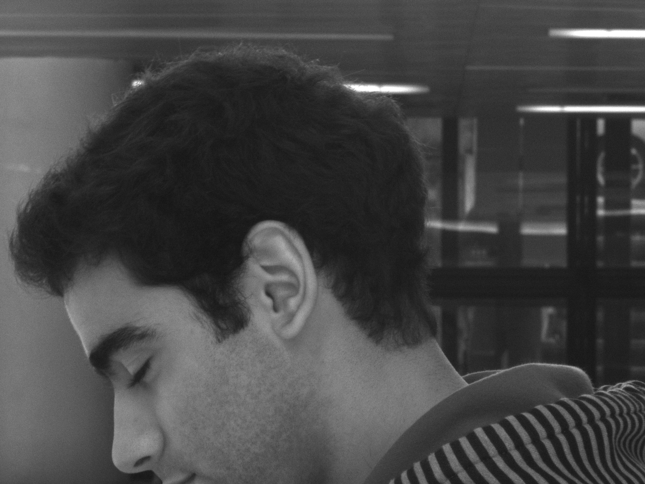
Model for Ear Detection
With the YOLOv5 Deep Neural Network, built with PyTorch
Many structures with pre-trained weights available
We used Yolo Nano for better performance
Trained for 60 epochs
1-30: Full dataset. Problems with bias
31-60: Random cropping around the ear. Working properly
Dataset: UBEAR
Face profiles in real world conditions
Noise factors: occlusion, illumination, hair, earrings
Input pre-processing
Transform the frame to grayscale
Resize to YOLO’s input format
An image from the UBEAR dataset

Slide 5
Comparison between YOLO models
Model | size ^{(pixels)} | mAP^{val} ^{0.5:0.95} | mAP^{val} ^{0.5} | Speed ^{CPU b1} ^{(ms)} | Speed ^{V100 b1} ^{(ms)} | Speed ^{V100 b32} ^{(ms)} | params ^{(M)} | FLOPs ^{@640 (B)}
YOLOv5n | 640 | 28.4 | 46.0 | 45 | 6.3 | 0.6 | 1.9 | 4.5
YOLOv5s | 640 | 37.2 | 56.0 | 98 | 6.4 | 0.9 | 7.2 | 16.5
YOLOv5m | 640 | 45.2 | 63.9 | 224 | 8.2 | 1.7 | 21.2 | 49.0
YOLOv5l | 640 | 48.8 | 67.2 | 430 | 10.1 | 2.7 | 46.5 | 109.1
YOLOv5x | 640 | 50.7 | 68.9 | 766 | 12.1 | 4.8 | 86.7 | 205.7
YOLOv5n6 | 1280 | 34.0 | 50.7 | 153 | 8.1 | 2.1 | 3.2 | 4.6
YOLOv5s6 | 1280 | 44.5 | 63.0 | 385 | 8.2 | 3.6 | 12.6 | 16.8
YOLOv5m6 | 1280 | 51.0 | 69.0 | 887 | 11.1 | 6.8 | 35.7 | 50.0
YOLOv5l6 | 1280 | 53.6 | 71.6 | 1784 | 15.8 | 10.5 | 76.7 | 111.4
YOLOv5x6 | 1280 | 54.7 | 72.4 | 3136 | 26.2 | 19.4 | 140.7 | 209.8
+ TTA | 1536 | 55.4 | 72.3 | - | - | - | - | -

Slide 6
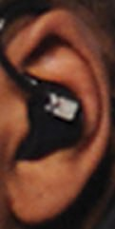
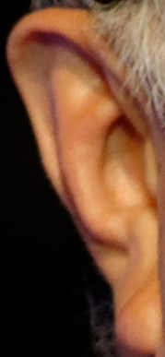
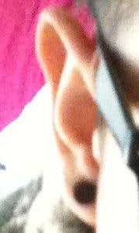
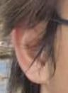
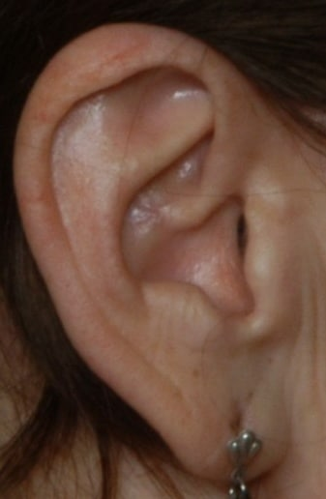
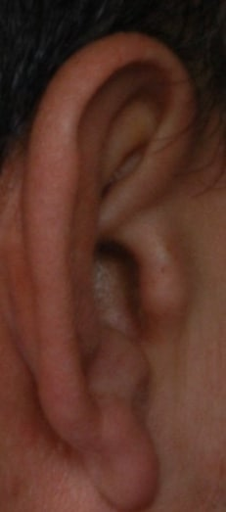
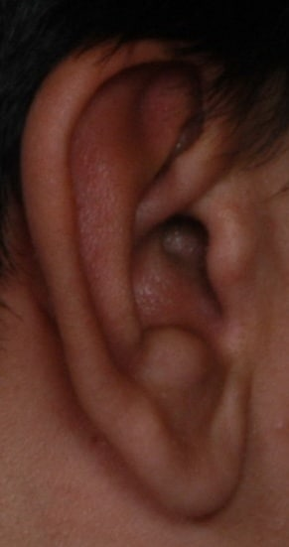
Model for Feature Extraction
Based on MobileNet, built with TensorFlow
Lightweight model, pre-trained on the ImageNet dataset
Around 4M parameters
Trained on EarVN and part of AMI
The images of AMI were cropped using the Yolo detection model
Previous models were trained on AWE and EarVN alone
Results were not satisfying
Approach based on this paper
Training Convolutional Neural Networks
with Limited Training Data for Ear Recognition in the Wild
Input pre-processing:
Values are normalized to [-1,1]
Images are scaled down to 224x224
Output format: vector of 1280 features
Images from the AWE dataset
Images from the EARVN dataset
Cropped Images from the AMI dataset

Slide 7
Enrollment

Slide 8
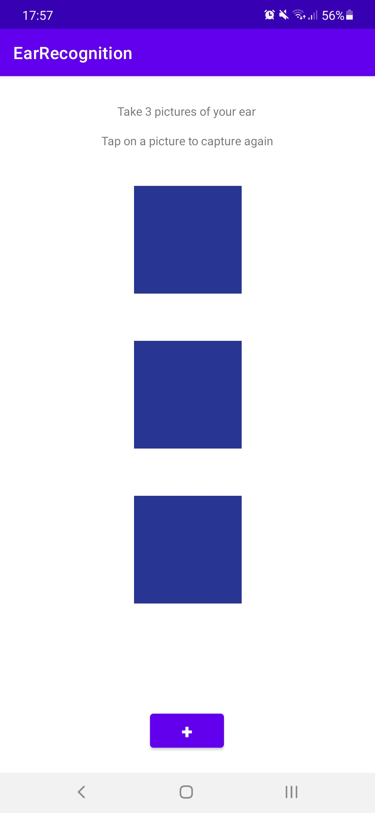
Enrollment steps
The app asks the user to take three pictures of the ear
The user can tap on an image to re-capture it
When the user taps Save, the app extract the features of the ear and completes the enrollment
Steps of the features’ extraction:
Localize and segment the ear with Yolo and OpenCV
Use the TensorFlow model to extract the features
Store them as a vector in the app
Screenshot of the enrollment procedure

Slide 9
Verification

Slide 10
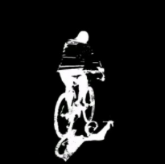
Motion Detection
Avoid triggering the neural network at each frame
Given two consecutive frames, compute their difference
The common part is black
The different part is white
If the white area is below a certain threshold, the camera is stable
The app can now trigger Yolo to perform an object detection
Advantages
Increased framerate
Avoid useless processing of blurred images
An example of difference of frames

Slide 11
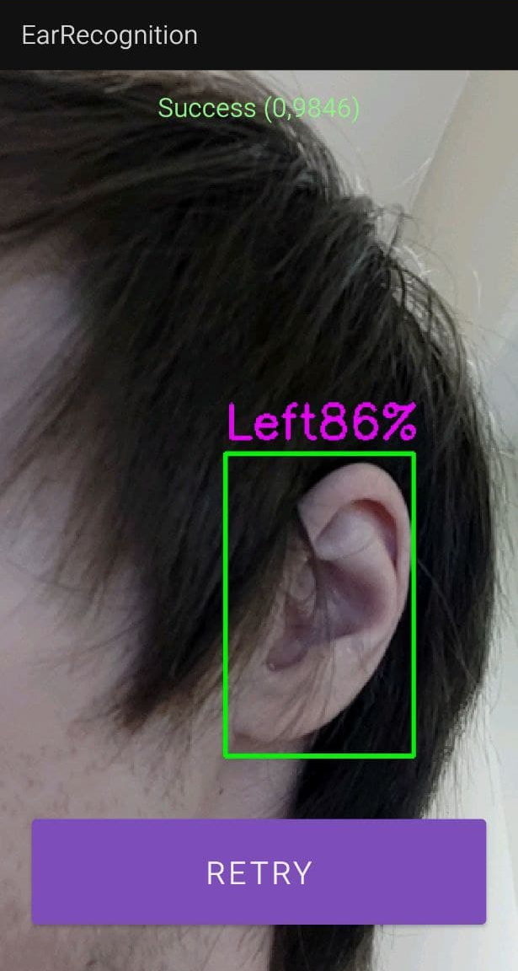
Verification and matching
When the camera is stable enough, Yolo is triggered and tries to recognize the ear
If the ear is detected, the app passes the frame to the TensorFlow model for the extraction of the features and builds a probe vector with them
The probe is compared with the templates in the gallery
Similarity measure: correlation
Match: the phone emits a vibration feedback
No match: the phone vibrates for a longer time
No input needed from the user!
Put the camera to frame the ear, don’t move it for a second, and wait for the response
TODO inserire screenshot del matching

Slide 12
Performance evaluation

Slide 13
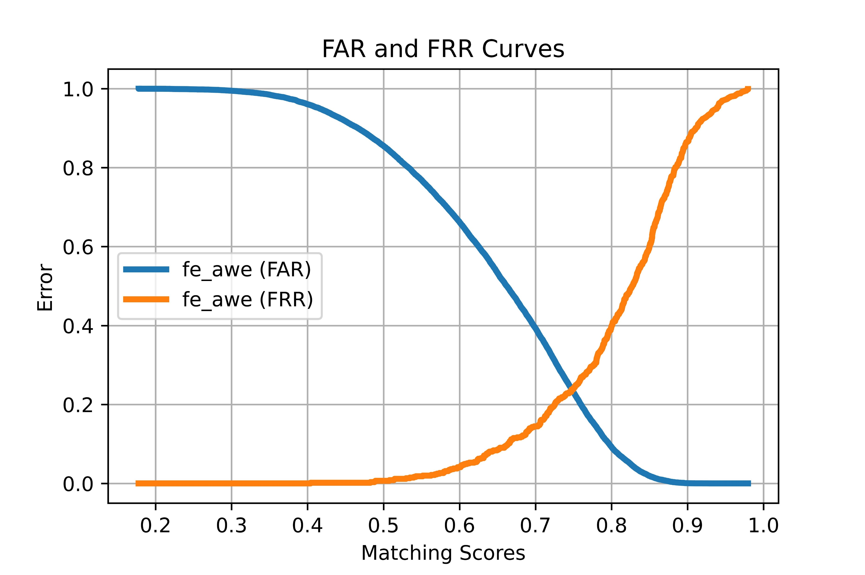
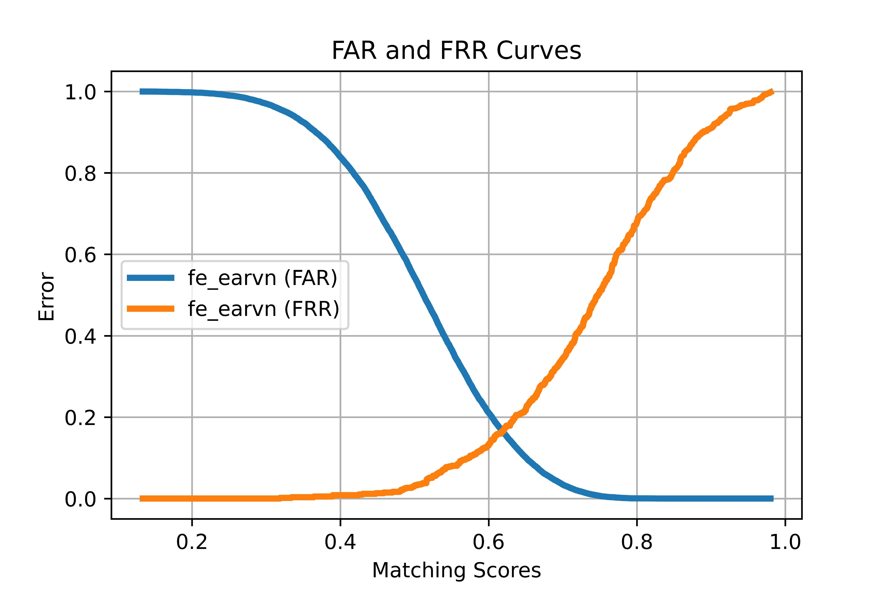
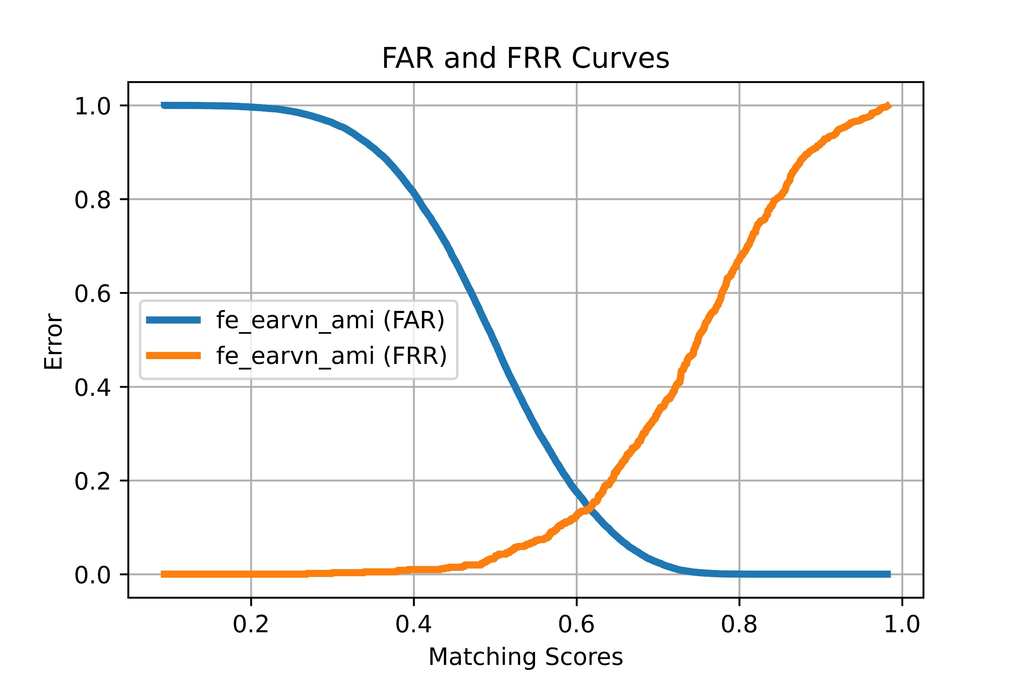
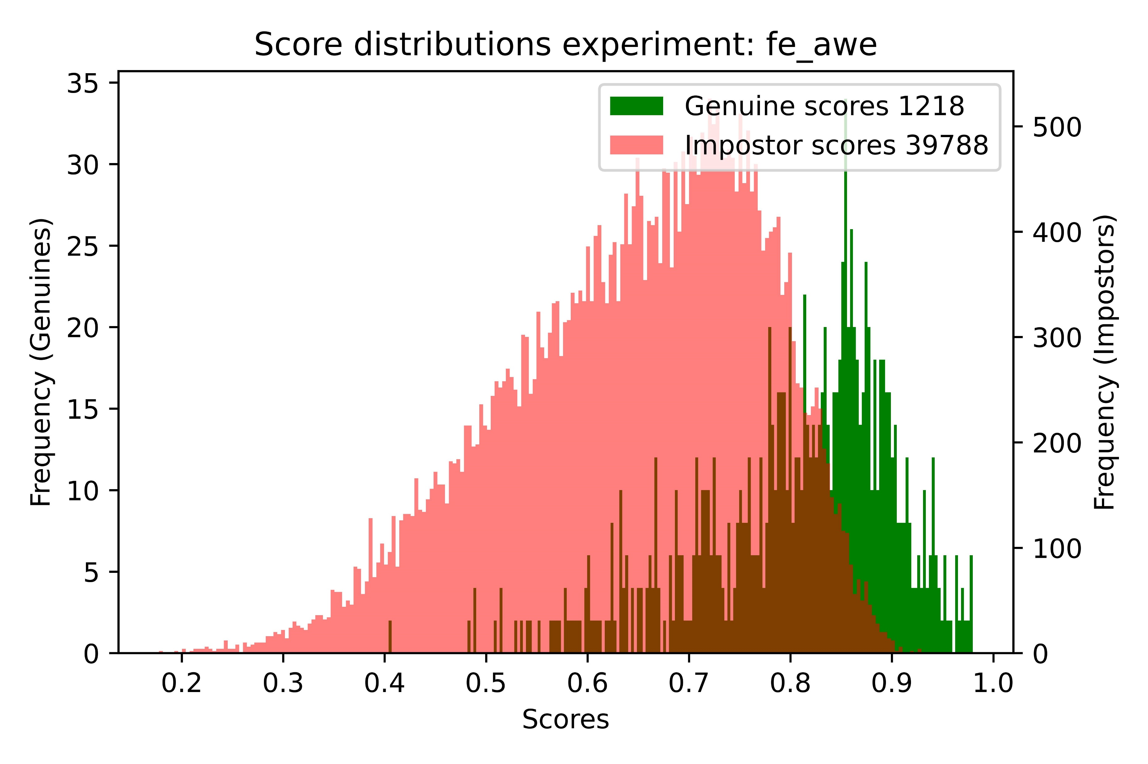
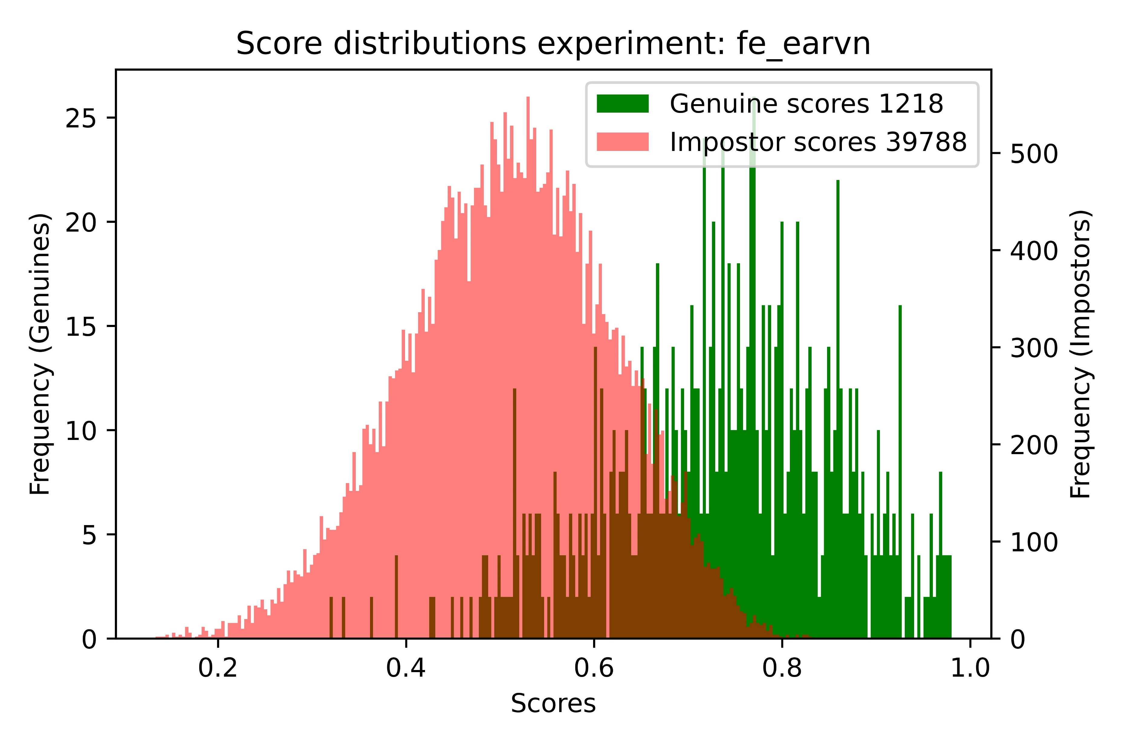
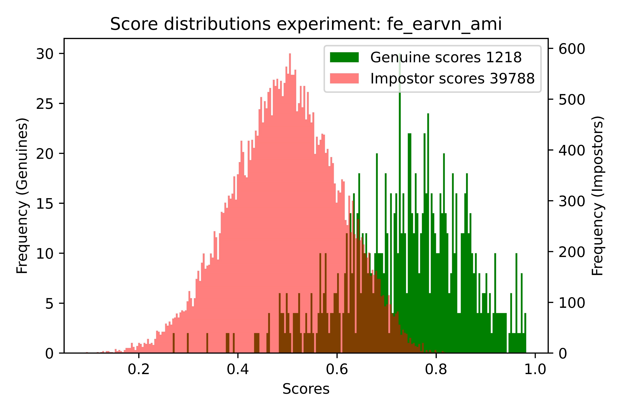
Evaluation on AMI 1/2

Slide 14
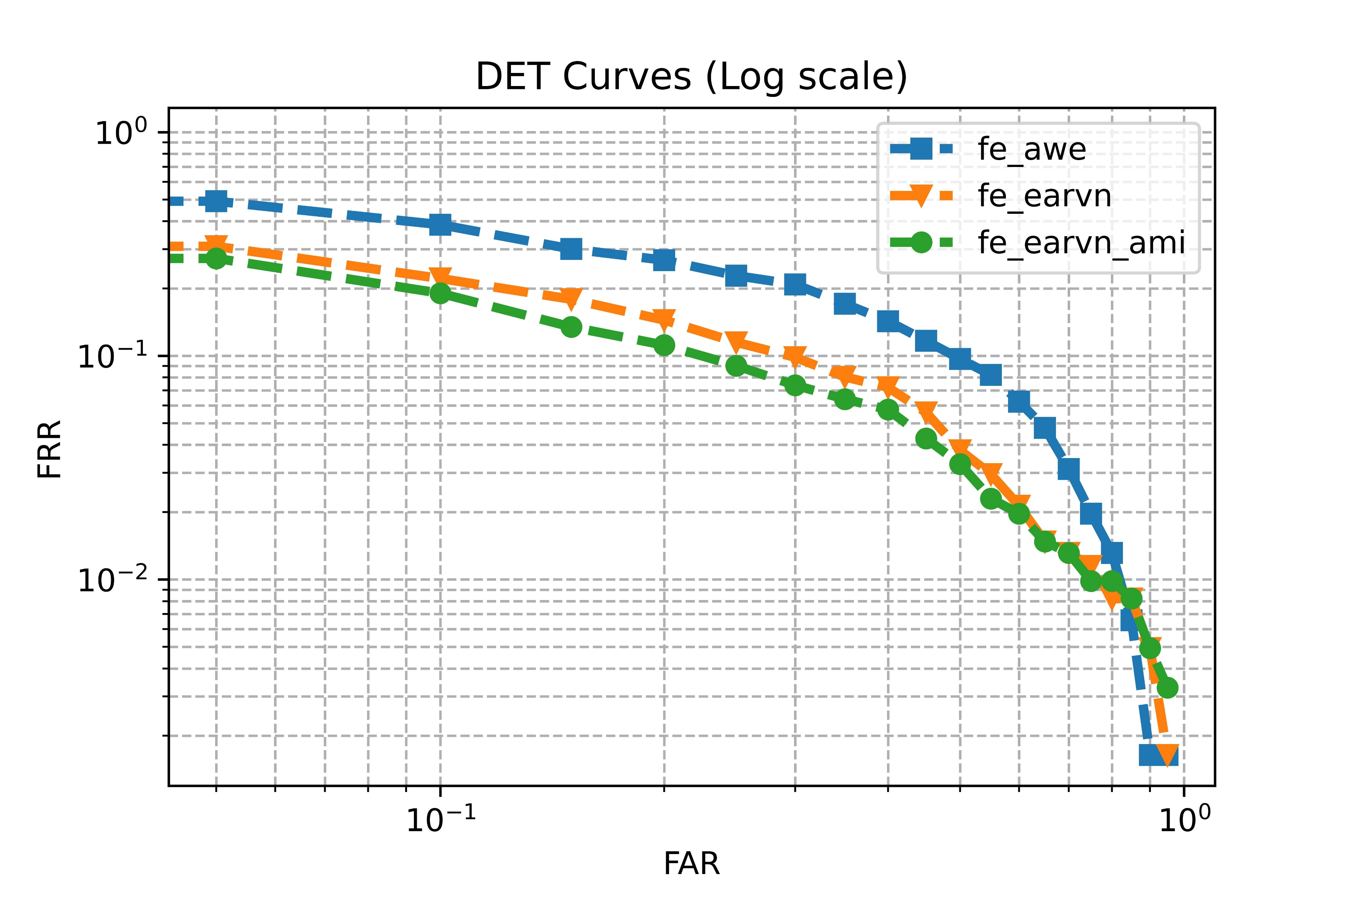
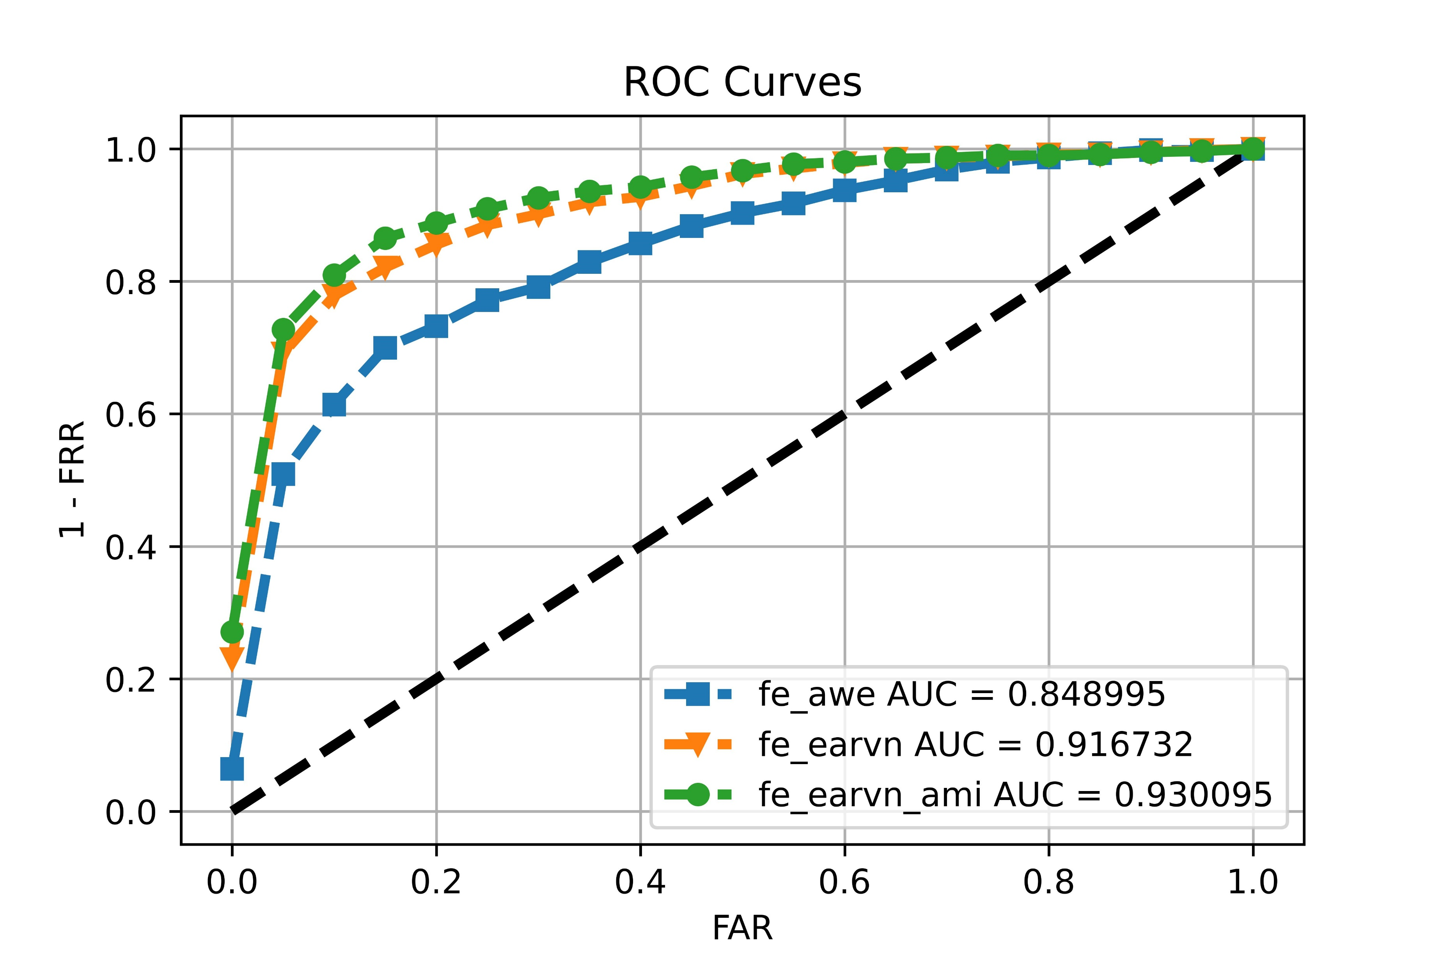
Evaluation on AMI 2/2

Slide 15
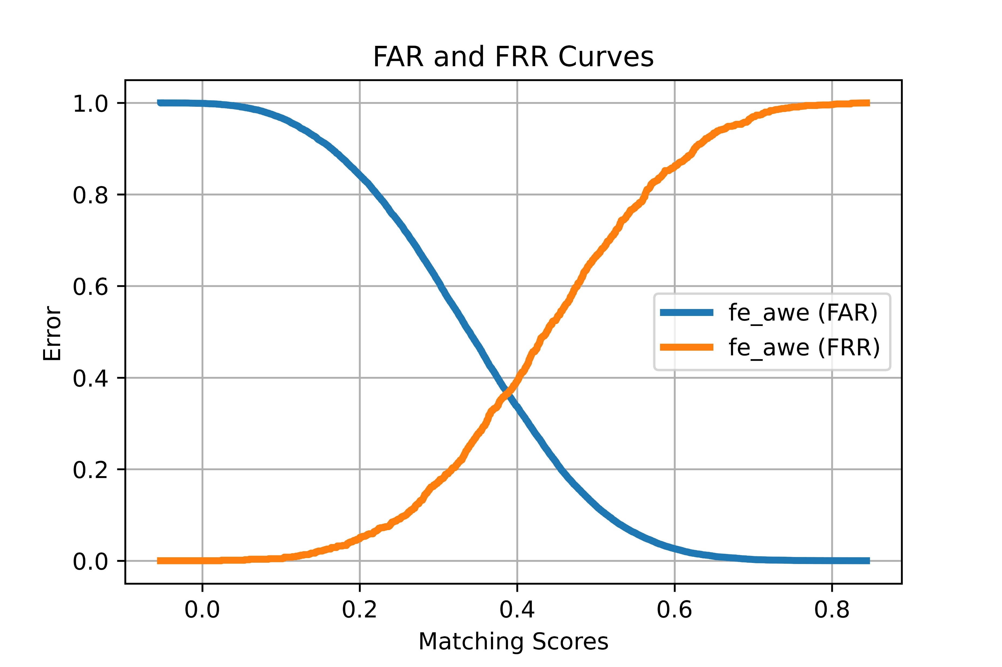
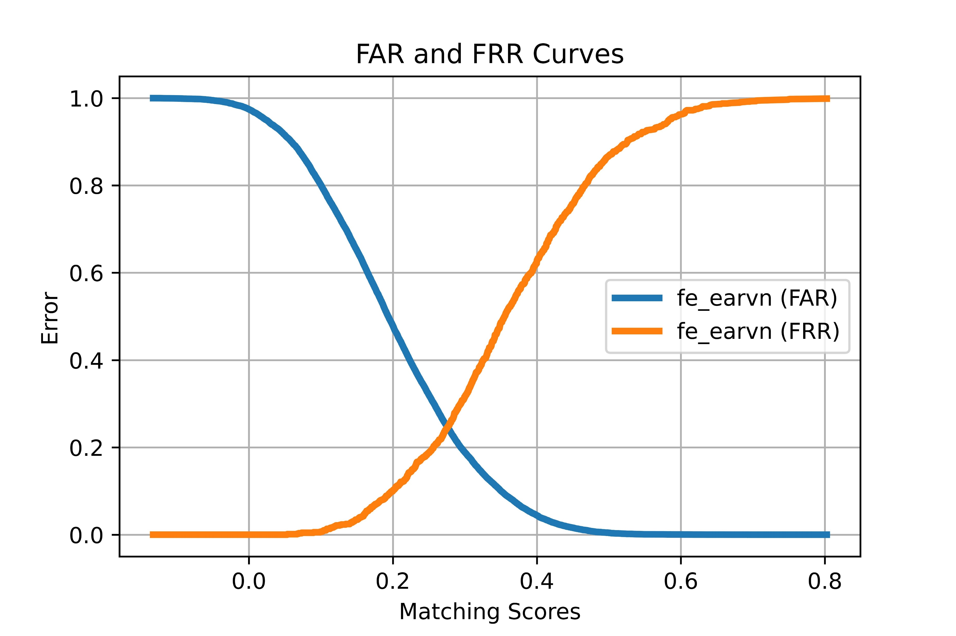
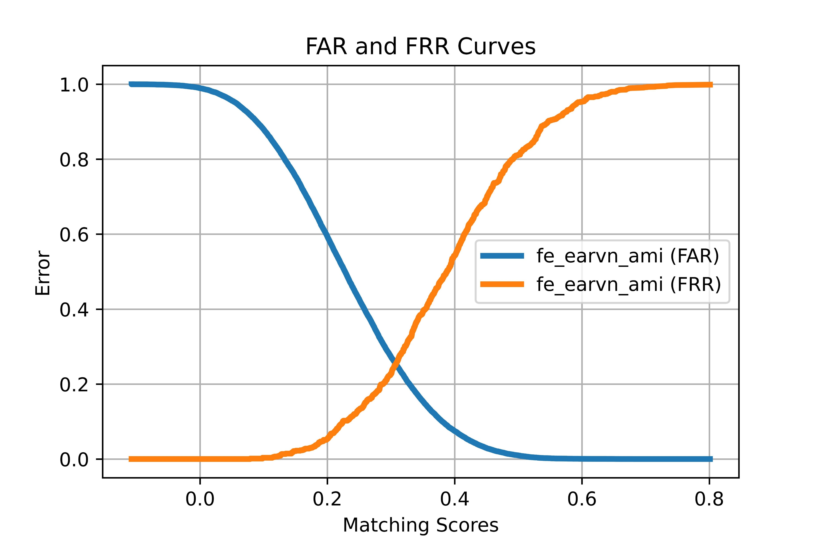
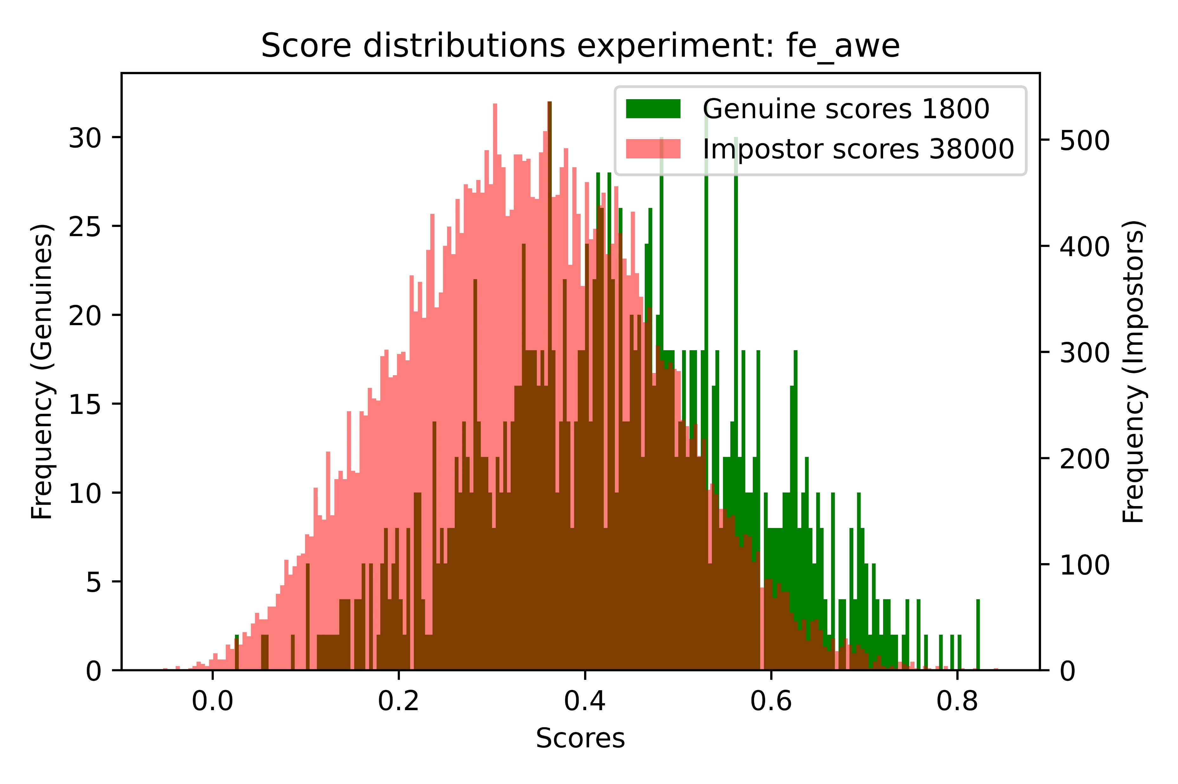
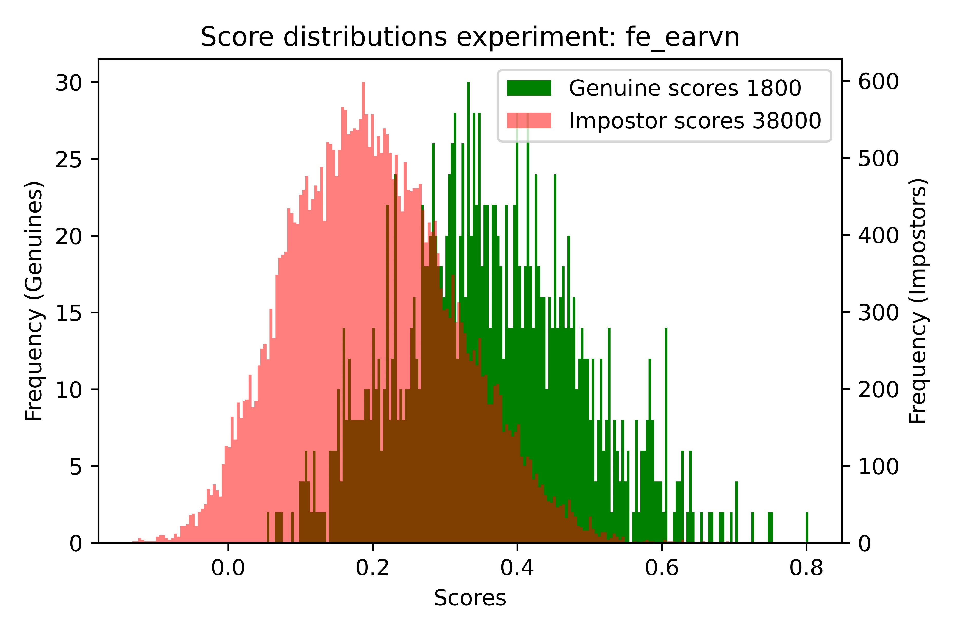
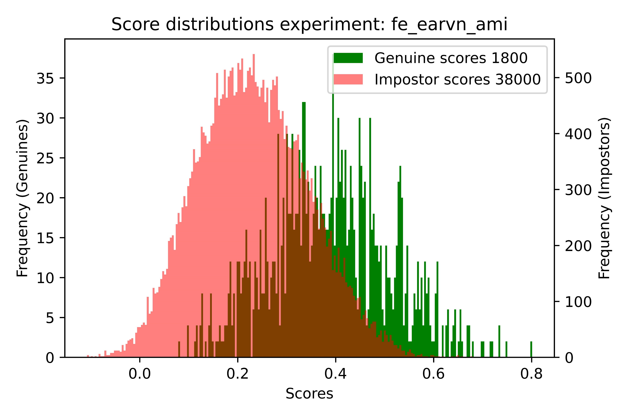
Evaluation on AWE 1/2

Slide 16
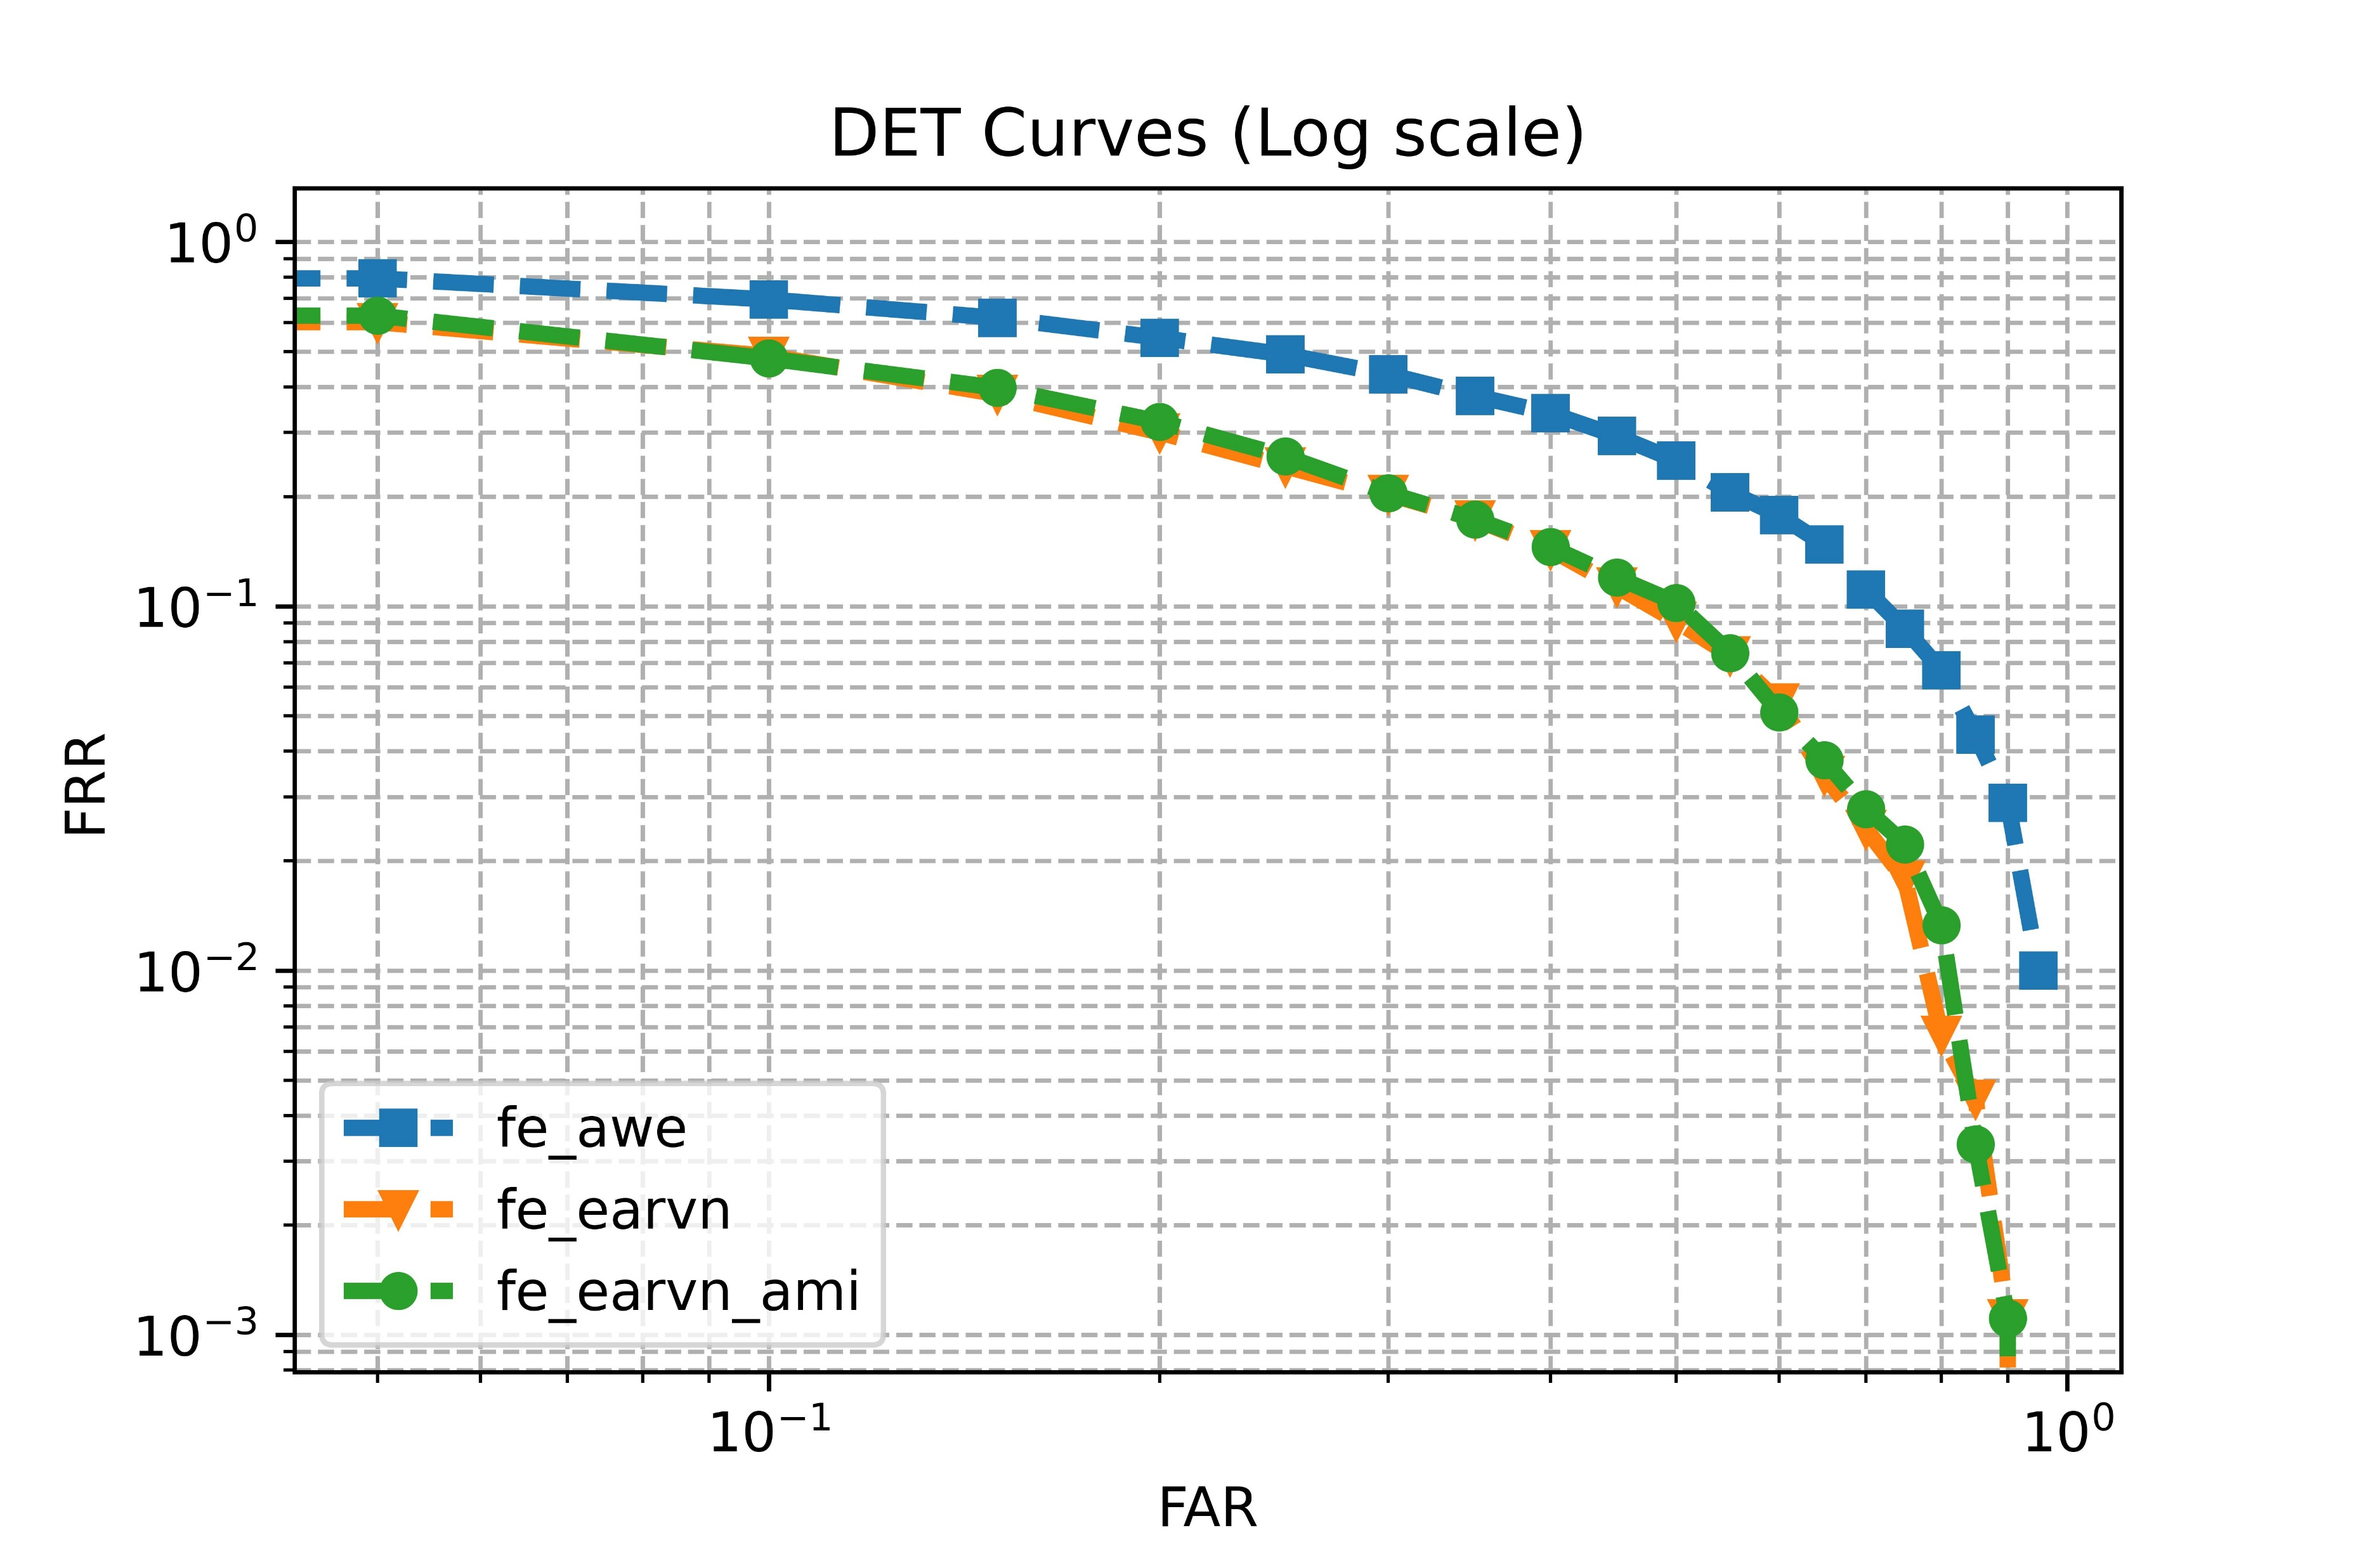
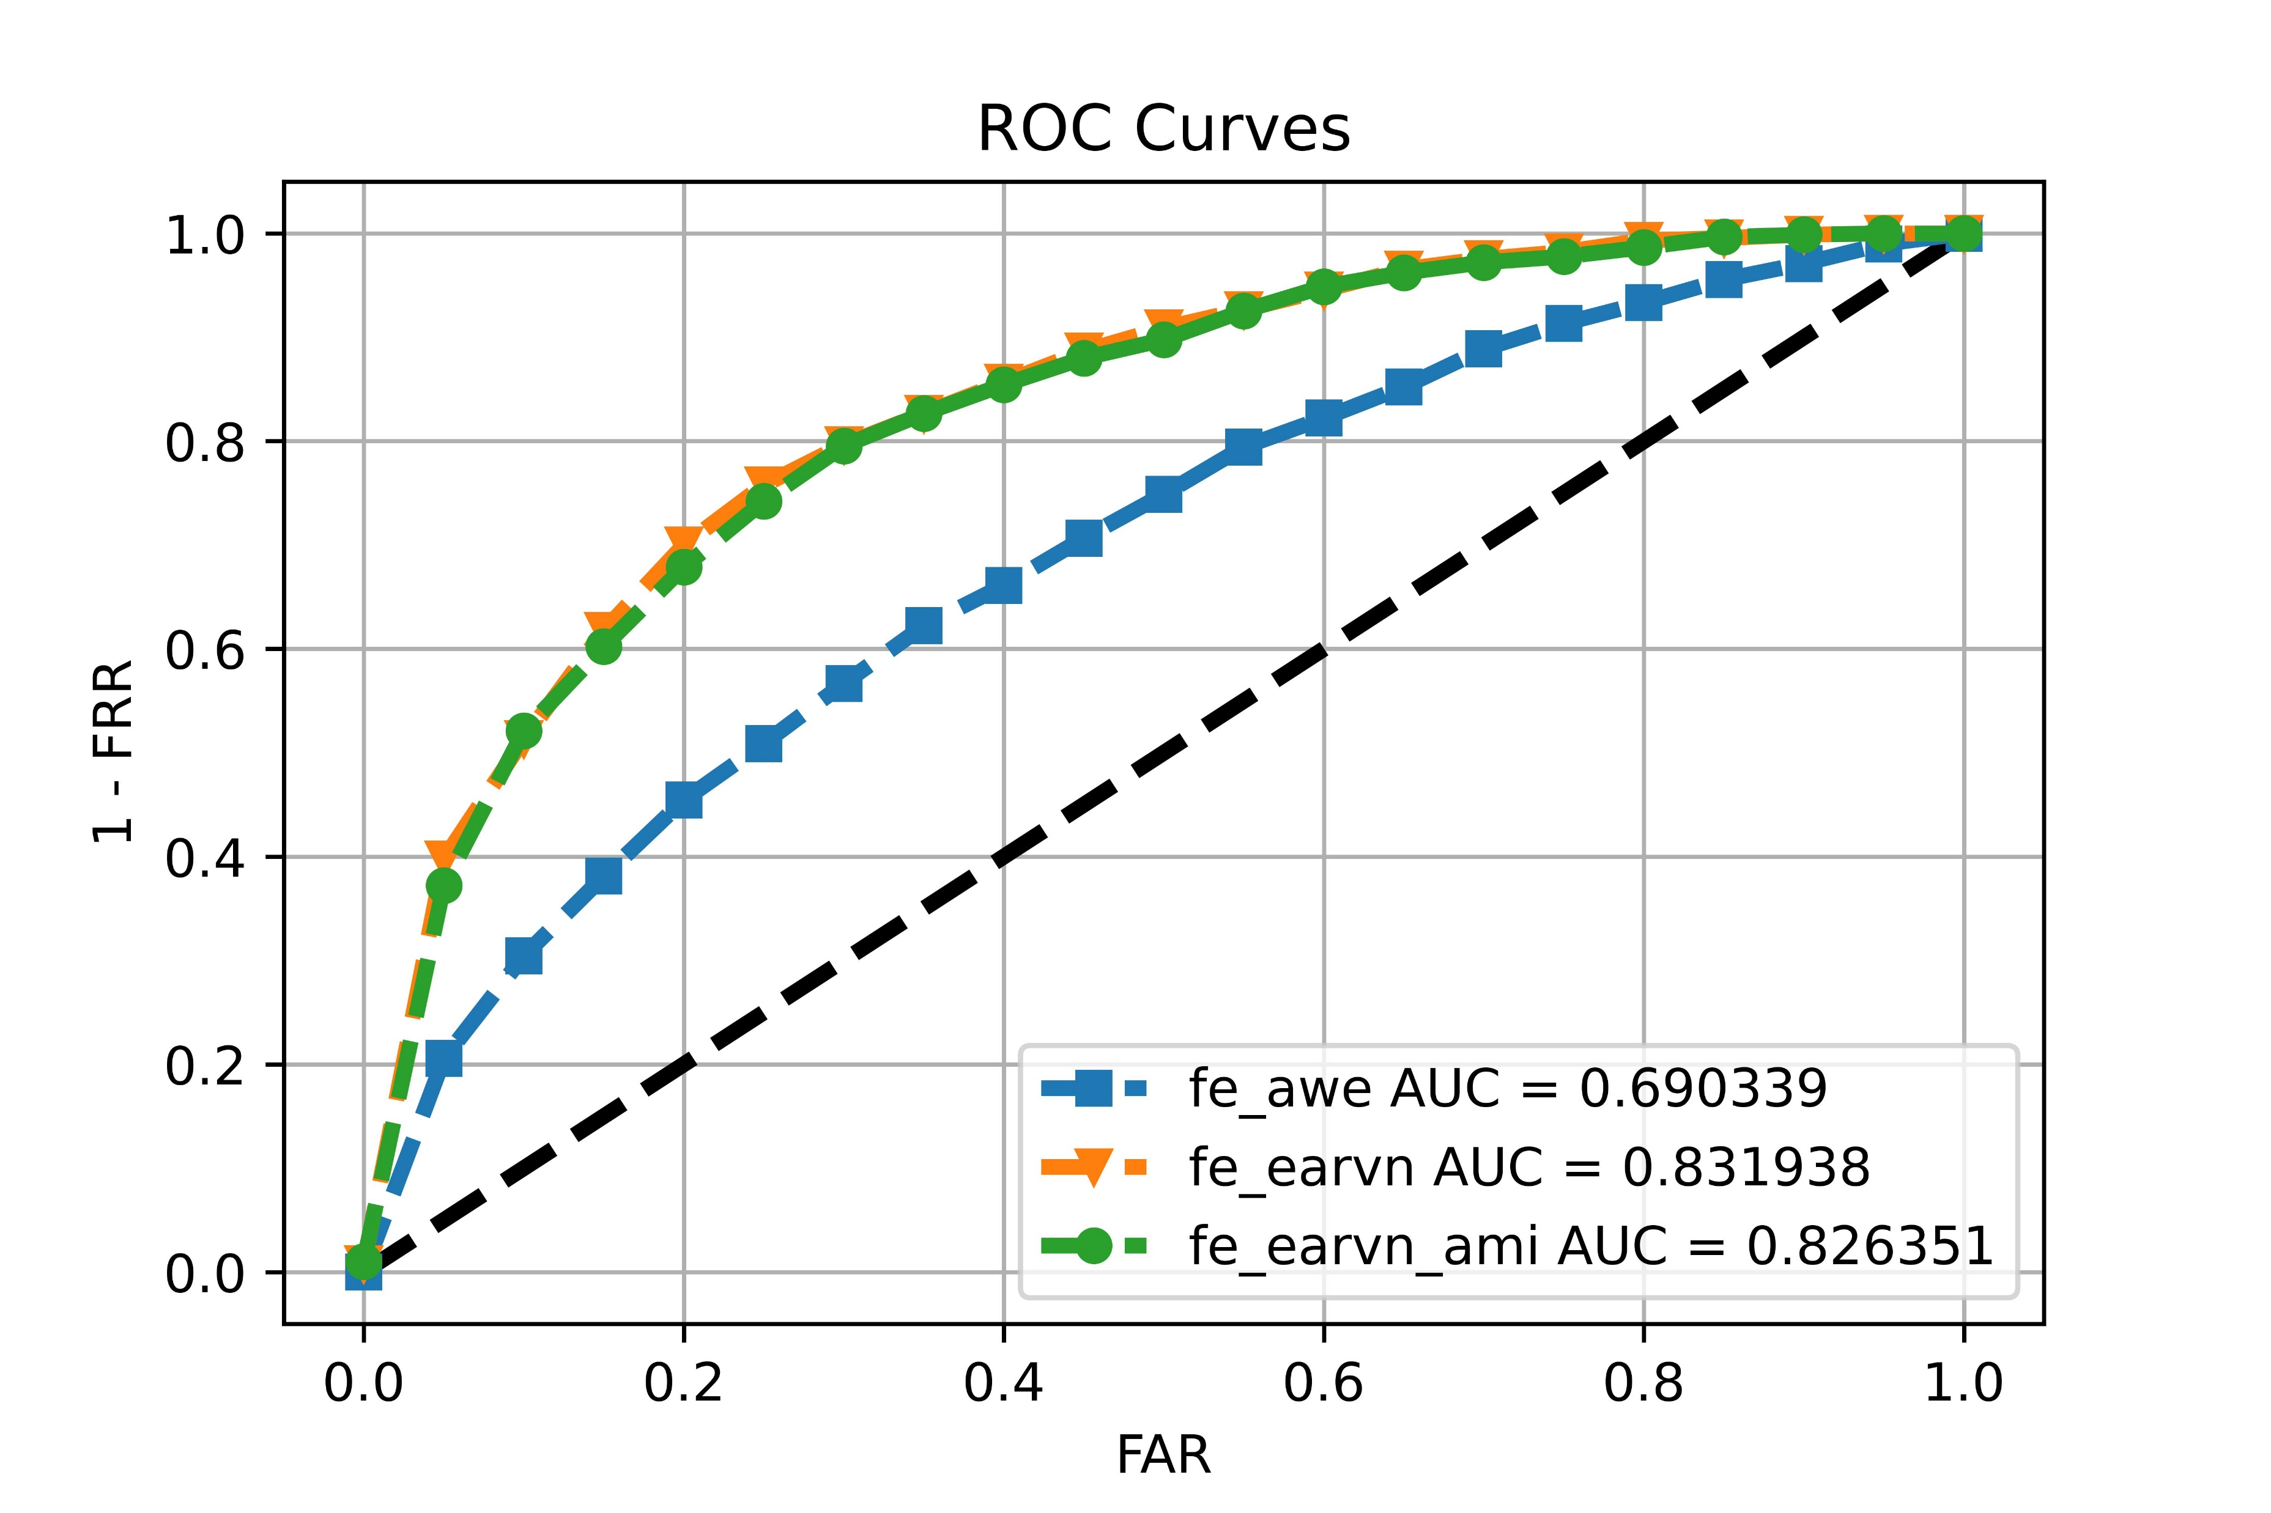
Evaluation on AWE 2/2

